Slide 1
Understanding YOUR ROC’s financial statements

Slide 2
Who are we and why can we help?
We are Brenda Richter an accountant and controller for Newby Management and Jan Provence a CAM Manger with Newby Management.
Newby Management has been serving Mobile Home communities since 1975 and manages ROC’s throughout Florida.

Slide 3
agenda
Introduction
Budgeting
Financial Statements
Treasurers Report
Reserves

Slide 4
The finances of your community may seem like a mystery when you first come to a position on a board However, it is important you have a basic understanding. It is in fact part of your fiduciary duty to your community. Many of your residents do not actually understand the reports provided and if they ask you a question it is good to feel confident in your ability to answer their questions…… or at least be able to direct them to someone who can.

Slide 5
WHAT IS A COMMUNITY BUDGET
Well simply put it is exactly what is sounds like. It is the planned expenses for the community for the upcoming year
It can be divided in to both operating and reserves.
It is usually prepared by the treasurer and a committee of owners/residents.
It is reviewed and approved by the board or sometimes the members.

Slide 6
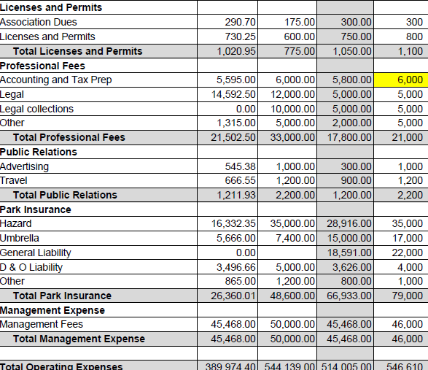
You need to budget both Income and Expenses

Slide 7
Where do the numbers come from?
The budgeting process involves the gathering information on the previous and current years income and expenses and then making projections for the upcoming year.
REMEMBER if you have any special maintenance planned that is NOT a reserve expense it needs to be put into the budget. For instance, you may plan to switch to hand blowers instead of paper towels in community bathrooms. Budget for this do not reserve for it.

Slide 8
Financial Statements
Financial Statements are usually prepared by your accountant or bookkeeper.
They should be reviewed often preferably monthly by your manager and treasurer
They typically give a lot of detailed information most of which is NOT required reading for everyone
They are the base of the Treasurer’s Report
They included a list of the communities' total assets and liabilities
They typically will show the income and expenses for the month and year to date.
They may list the GL’s or general ledger entries used to track various categories of income and expenses.
They may list accounts in arrears and will list prepaid assessment and fees.

Slide 9
Treasurers Report
If you are a Chapter 617 not-for-profit or a 607 for-profit corporation you need to provide a treasurer's report at least annually.
Most ROC boards will have a report given by the Treasure at all board and member meetings. The report should include financial transactions, such as income and expenses and include the corporation's cash balance(s) at the end of the reporting period.
607 corporations which are for profit may also have share dividends to report depending on what their documents allow for.

Slide 10
Treasurers Report Example

Slide 11
TO RESERVE OR NOT TO RESERVE ?
For FS719 and FS720 communities creating reserves is largely optional although highly encouraged. However, if membership has voted to establish a reserve fund(s) for a specific item like roads, that money cannot be used for anything else and the fund must be funded every year unless there has been a specific vote of the members to not fund.
This would be referred to as a Statutory Reserve Fund.

Slide 12
Reserve Funding considerations
This fund can be a series of separate items with the monies kept separate called “Straight Line” or as is most common in ROC communities, what is called “Pooled Reserves” or “Cash Flow Reserves”.
While the intent of both is exactly the same the pooled reserve method gives more flexibility to a board. For instance, if you have a roofing reserve in the straight-line accounting method and your roof needs to be replace a little sooner than you projected and the amount in the fund is $5,000 less than needed, you would need to have a vote to move funds from one reserve to another or do a special assessment to gather the balance of what is needed. If the reserves are pooled than the amount can be taken out of the collective “pot” and in the following years budget you can recalculate what is needed to correct for the other funds.

Slide 13
Maintaining a good reserve fund?
Review annually and adjust cost and life expectancy numbers as required
Things change – delete and add reserve items as appropriate. If your community decides to build Pickle Ball courts then the ongoing major maintenance like surface replacement need to be added to the reserve. If you had mini golf but decide it is not used and you are going to remove it then take it out of reserves.
*** Remember if you declaration document mandates a pool and shuffle board courts then you should continue to provide it even if it is an under used facility.

Slide 14
Uncommon reserve items
Consider:
Reserving for uninsured damage and legal fees. Many ROC’s have huge bills after a catastrophic event that insurance is not sufficient to cover. If you can build reserves sufficient to cover deductibles and or the cost of horticulture damage, which is usually uninsured, you will be in much better shape.
Reserving for unexpected legal fees. , while you should and likely do have D & O insurance having a legal war chest for an uninsured legal matters can be comforting for your residents.

Slide 15
Reserve Fund example

Slide 16
Special Assessment CAN be levied if permitted in governing documents. 1. After a special, properly noticed, meeting with members/shareholders. 2. Against only those members/shareholders that are part of the corporation – cannot special assess lot rental units unless lease or other documents clearly state this possibility. 3. Must allow a reasonable time period for payment. 4. If a special assessment is to pay back into reserves for the expenditure, then it must be paid back within a year.
The last resort

Slide 17
Thank you

